Slide 1
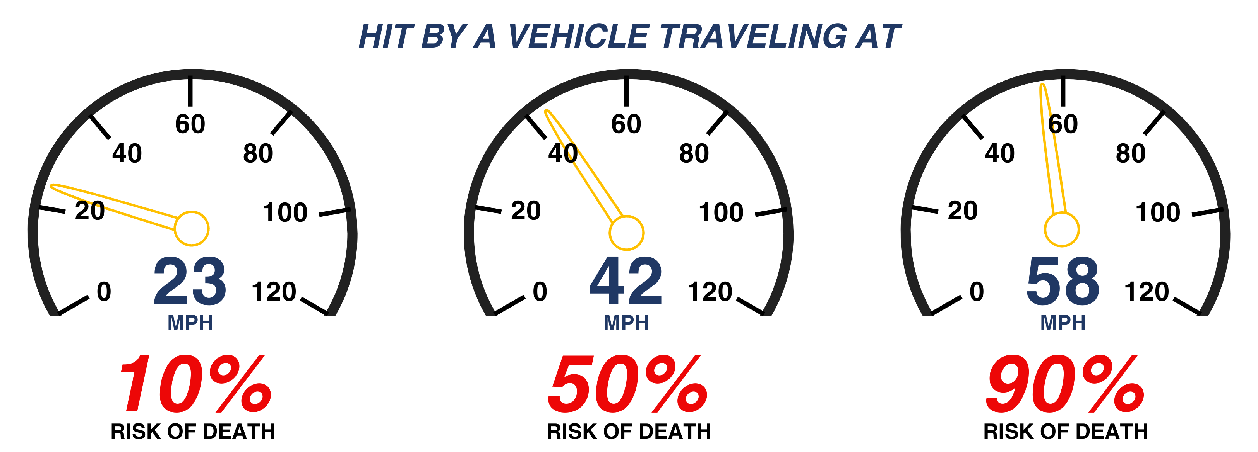

November 17–21, 2025
CRASH RESPONDER SAFETY WEEK
Safety Starts With You
Slow Down and Move Over!
Every six seconds a traffic incident responder is working roadside to keep all road users safe. This Crash Responder Safety Week (CRSW), and every week, we urge you to know, share, and follow [your state]’s Move Over law.
<insert the State law specifics for whom to move over for>
<insert your State law specifics on how much to slow down>
<insert your State Law’s penalties>
<If applicable, insert your State’s Driver Removal Law, otherwise cite the number of roadway fatalities in your State or region.>
This CRSW, share a story of how you were helped by a firefighter, police officer, tow operator, safety service patrol person, or other crash responder. Be sure to use #CRSW and tag us! And remember, Safety Starts With You –Slow Down and Move Over!
*INSTRUCTIONS TO REMOVE LATER: Enter a photo of responders in your organization here.
Source: Enter source here
@FederalHighwayAdmin
@[Your Organization]
@federalhighwayadmin
@[Your Organization]
@USDOTFHWA
@[Your Organization]
Your Organization’s Name and Logo Here

